Slide 1


Tandem Connectionist Feature Extraction for Conversational Speech Recognition
Qifeng Zhu, Barry Chen,
Nelson Morgan, Andreas Stolcke
ICSI & SRI
June 21, 2004
Tandem Connectionist Feature Extraction for Conversational Speech Recognition

Slide 2
Using Multi-Layer Perceptron (MLP) in Feature Extraction for Speech Recognition
Acoustic modeling: a machine learning algorithm to learn phone posteriors (Hybrid system).
Data driven feature extraction / data driven nonlinear feature transformation (Tandem system).
This work extends the second approach. We present some properties of MLP based transform, the recognition system set-up and the recognition performance with this novel feature.
It’s about the feature

Slide 3
MLP outputs as features to HMM
MLP outputs: phone posterior approximation
Regular within distribution in feature space with simple class boundary (easy to model)
Reducing target irrelevant information (such as the speaker variation)
Easy to combine different MLP features, effective in improving performance without increasing feature dimension (to avoid the ‘curse’)
We will show these properties in more detail ……

Slide 4
*1 Simple and Regular Within-Class Distribution
Class boundary approximates the optimal equal-posterior hyper-plane.
Nearly-flat distribution for the ‘in-line’ feature component (the posterior of the underlying class)
‘Off-line’ components distribute close to zero.

Slide 5
Exp. 1: Posterior Feature Space
Feature space of the three MLP components corresponding to /ah/(triangle), /ao/ (star), and /aw/ (circle).
Each class is a “stick”
Posterior feature space with value in [0,1]

Slide 6
Exp. 2: Log Posterior Feature Space
Logarithm can further manipulate the distribution to avoid vary sharp distribution of the ‘off-line’ component.
Each class is a “pie” after logarithm.
Log-posterior feature space with value in (-∞, 0]

Slide 7
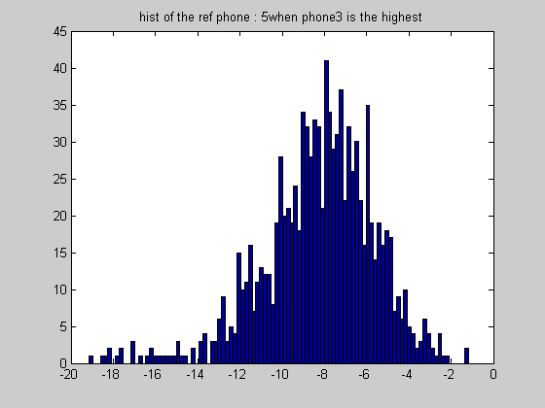
Exp. 3: Typical Distributions of Log Posteriors in Histogram
‘In-line’ component
‘off-line’ component
-2
0
-18
-2

Slide 8
*2 Reducing Speaker Variation
Posteriors are by nature speaker independent, if trained with speaker balanced data.
The MLP output, as the posterior approximation, carries this property.
To show this, we compare the variances of the SAT transform matrices for different speakers with both PLP feature and MLP feature, both mean/variance normalized. MLP feature has smaller average variance.

Slide 9
Exp. 4: Variances of (Speaker Adaptive Training) SAT Transforms for Different Speakers
Speaker variation can be viewed as the variations of the SAT matrices on normalized features.
Ratio of the average variances in the PLP block (first 39 dim) and the MLP block (next 25 dim) =1.6
variances
feature dim
feature dim

Slide 10
*3 Feature Combination: Better Performance, No Dimensionality Increase
Combine PLP-MLP (full band/short term) and TRAPS (sub-band/long term) outputs as posteriors.
Use Inverse Entropy Weighting to combine two MLP outputs in the posterior level.
Both frame accuracy and recognition word accuracy get improved with the combined feature.

Slide 11
Usually What to Expect for a Feature Transform
Find the discriminative information (such as LDA).
Make the feature fit the model better, especially for the Gaussian likelihood computation(such as MLLT)
Reduce feature dimensionality to reduce computation and to avoid the ‘curse’.
With the good properties of the MLP outputs, MLPs can be viewed as a nonlinear feature transform for these purposes.

Slide 12
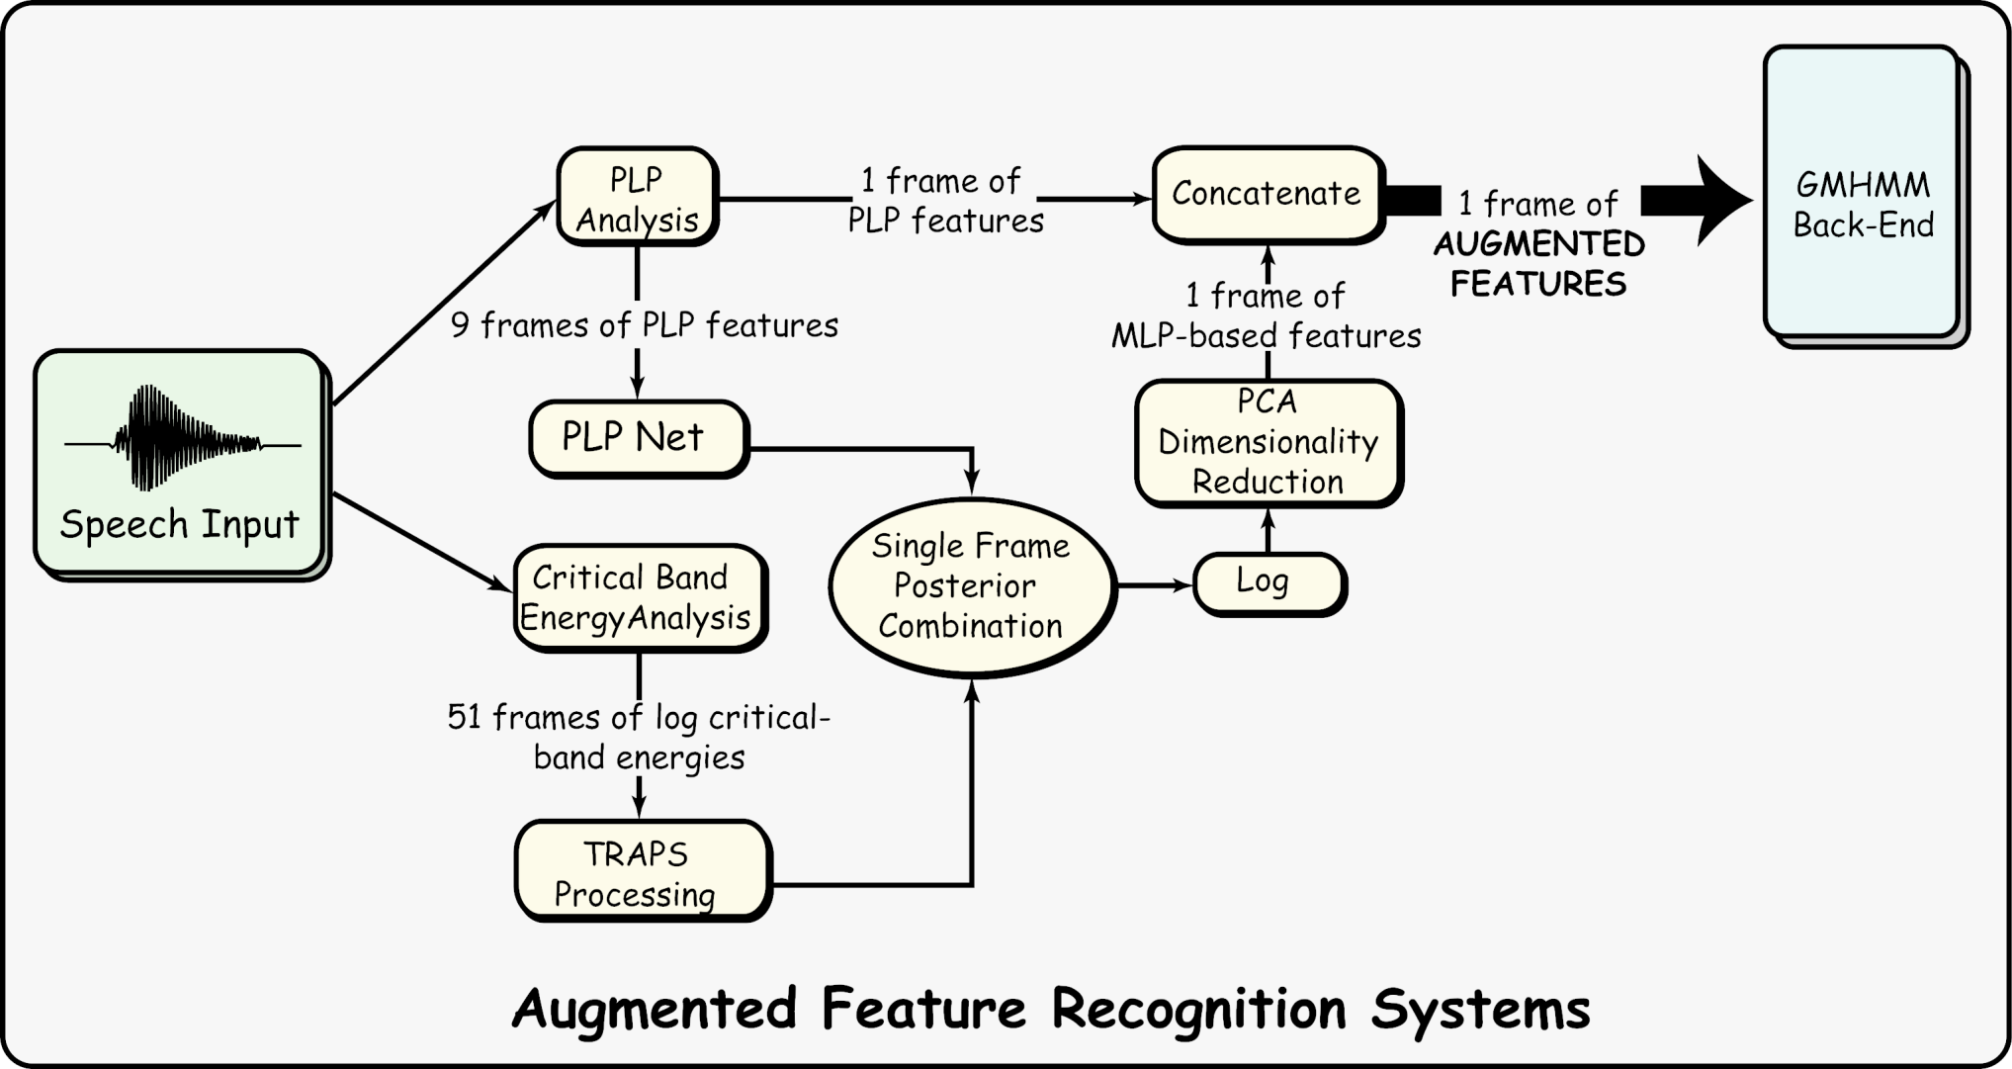
The Feature Generation Diagram

Slide 13
Some Practical Details in Feature Generation and HMM Decoding
Gaussian Weight Tuning for the augmented feature.
Another per-speaker normalization after MLP transform.
KLT based truncation can be applied without affecting recognition performance. (The first 25 dimensions keep 98% of the total variance.)
MLP features are appended to regular PLP features to form the final features for the HMM.

Slide 14
Recognition Experiments
Recognition task is the NIST 2001 Hub5 testset (6 hours conversational telephone speech).
Training uses 68 hours mainly from the Switchboard Corpus for the initial evaluation.
SRI Decipher system is used for these experiments.
Gender dependent HMM system, bi-gram LM, Nbest decoding and re-score, using VTLN, HLDA in the PLP baseline feature with first three derivatives.

Slide 15
Recognition with a ‘Plain’ System with ML Training
A 8.6% relative error reduction was achieved on this task using the combined MLP feature

Slide 16
Concerns for a Novel Feature: Scale and Carry Through
Scale to larger training sets
Improvements carry through with other advanced technologies:
Adaptation
MMIE discriminative training
Better LM rescore
System combination

Slide 17
Results with Adaptation
A 8.9% relative error reduction.
Block diagonal MLLR adaptation, no need to cross adapt the PLP feature with MLP feature
MLP feature works well with adaptation!

Slide 18
Results in a Full-Fledged System
Male only, 200 hours training, discriminative training and adaptation.
6.1%-8.2% error reduction with the advanced system.

Slide 19
Summary
Feature extraction is usually a bottom-top process. Most class-driven top-bottom supervised transforms are linear transforms.
MLP based data driven nonlinear feature transform works well in LVCSR task.
The work presented here discusses some nice properties of the MLP feature, which might be responsible for the improvement.
The End. Thanks.

Slide 20
MLP Training
PLP-MLP
MLPs with 46 phone targets can be trained with different inputs, taking different views of the time-frequency plane.
PLPMLP focus on full band short term, while TRAPs (HATs) focus on sub-band long term.
TRAPs
Different Inputs to MLP

